Slide 1
Crowd2Map Tanzania end FGM
File created on: 16-05-2021 11:57:54

Slide 2
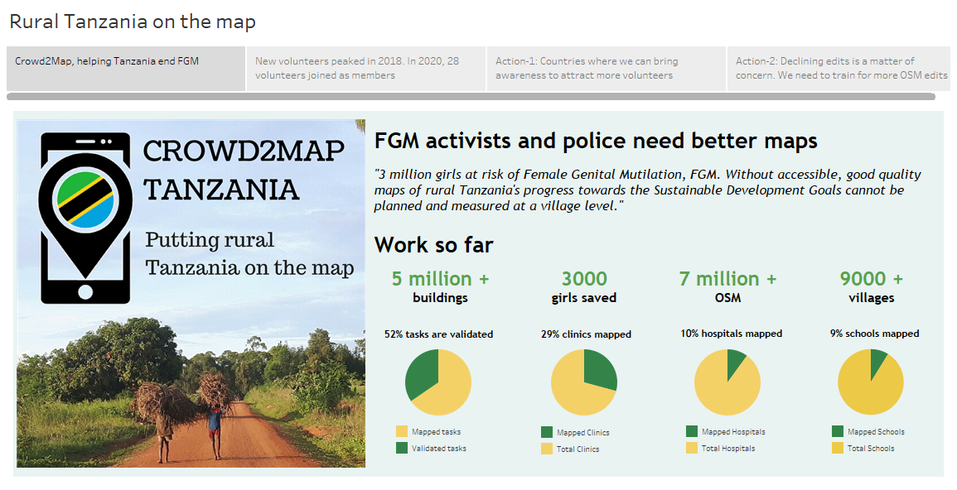

Slide 3
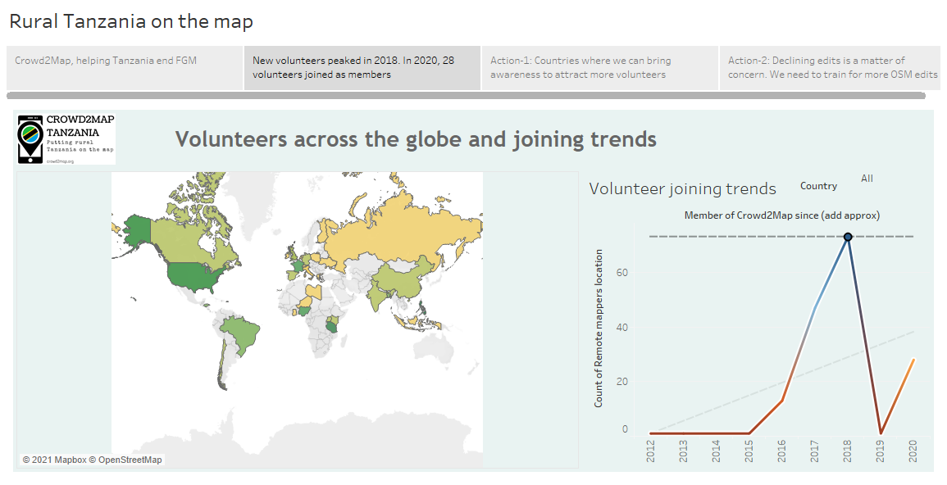

Slide 4
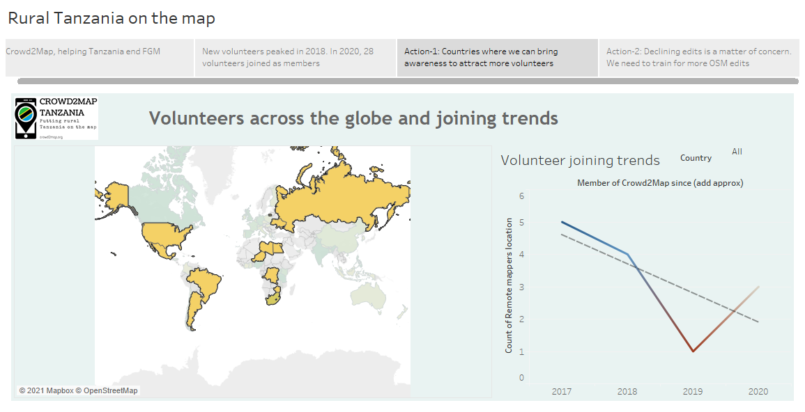

Slide 5
